Slide 1

Twitter clone Progressive Web Application
Team members
Vikram Kannan Muralidharan
Ashwin Agarkhed
Venkateshwaran Palanikumar
Vennela Karaddi

Slide 2
Highlights
Beautiful React Progressive web app which works seamlessly with both desktop and mobile phones with features like swipe right to comment on a tweet and swipe left to delete a tweet.
JWT based authentication system with secured routes.
User Accounts (login/register), post images with the tweet, set profile picture and ability to change profile picture.
Automatically censors offensive tweets. Replaces offensive words with *
Automatically scales pods depending upon the CPU usage of the pods
Quick response with cache mechanism
Monitoring using Prometheus and Grafana
Fully automated deployment with single command

Slide 3
Microservices (9)
API GATEWAY: Python Flask Microservice
RedisJSON Queue: A queue that contains an array of tweets.
RedisJSON Cache: A key value store which stores tweet_id as the key and the tweet_json as the value.
Queue Listener: Continuously polls the queue for incoming tweets. If a tweet is present, it tries to insert to the cache. If the cache is full (cache limit set to 5), it replaces the oldest tweet in the cache with the new tweet. It also sends the new tweet to the MongoDB Queue.
MongoDB Queue: Stores a list of tweets to be put into the database
Mongo Queue Listener: Gets multiple tweets at once from the queue and bulk inserts it to the database. Sets the queue to an empty array.
MongoDB: Database that persists all the data
S3 Worker: Its only job is to upload the images to S3 Bucket
React: A beautiful progressive web app built with a combination of material-ui, bootstrap and custom css

Slide 4
Infrastructure
Google Cloud (GCP) with microservices running on Kubernetes managed pods
AWS S3 to store and retrieve images
Prometheus and Grafana pods
Terraform for deployment of GCP and AWS resources and provisioning of pods

Slide 5
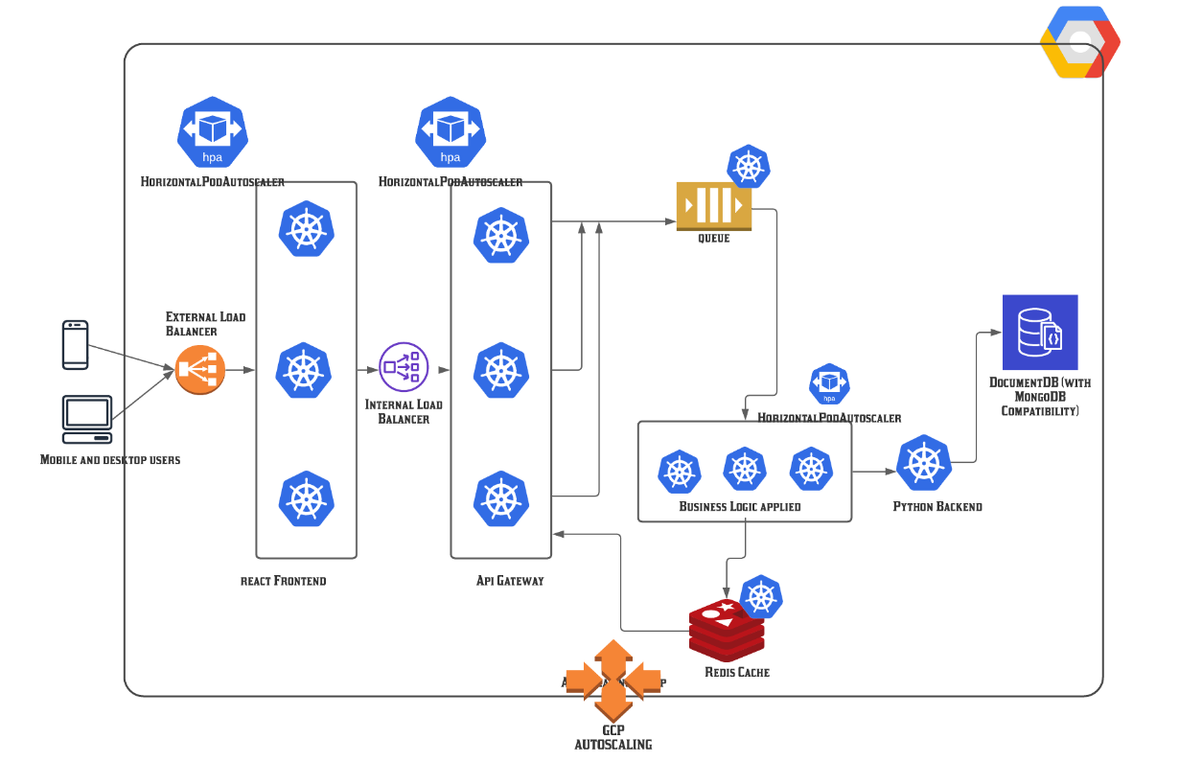
The Architecture looks like this:

Slide 6
API GATEWAY ENDPOINTS:
/login and /register allows users to login and register, respectively. Takes username and password as JSON request and returns a JWT token.
/get_tweets : gets the list of tweets in the cache and returns them as a JSON array.
/load_more_tweets : Checks if the cache is full. If not full, return no more tweets. Else, gets the remaining tweets from the database and returns it to the user sorted by date_posted newest to oldest.
Protected routes: (Requires a valid JWT token to access these routes)
/new_tweet : Send the new tweet to a queue of tweets
/delete_tweet : Deletes the tweet from both database and cache
/tweets/<id> : Get all the tweets posted by a user
/get_tweets_by_filter Ability to search the username or content
/like_a_tweet
/unlike_a_tweet
/add_a_comment

Slide 7
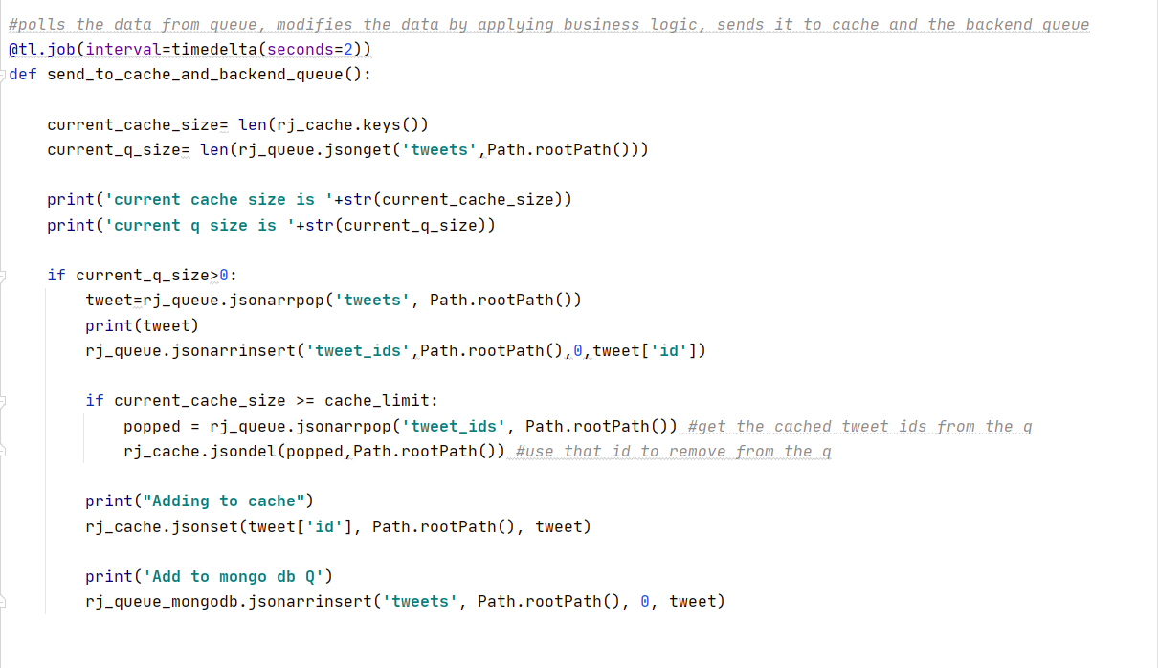
Queue Listener

Slide 8
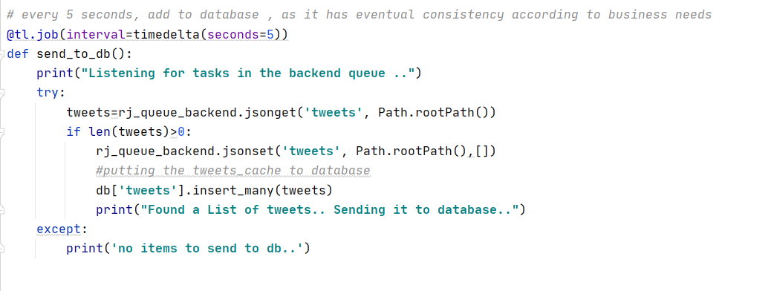
MongoDB Queue Worker

Slide 9
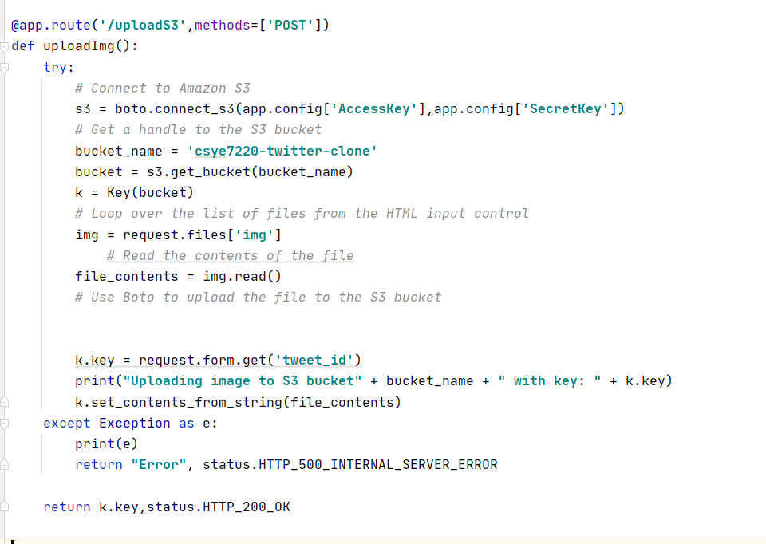
S3 Worker

Slide 10
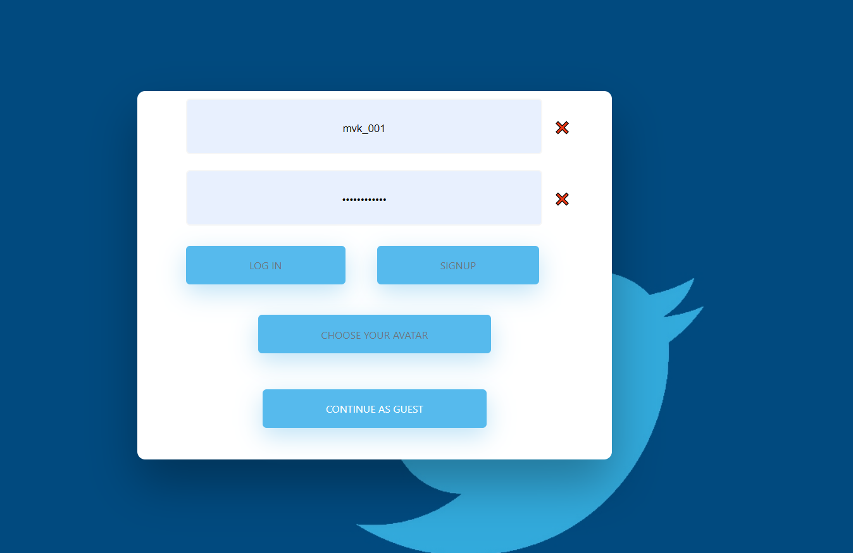
Screenshot – Login/Signup

Slide 11
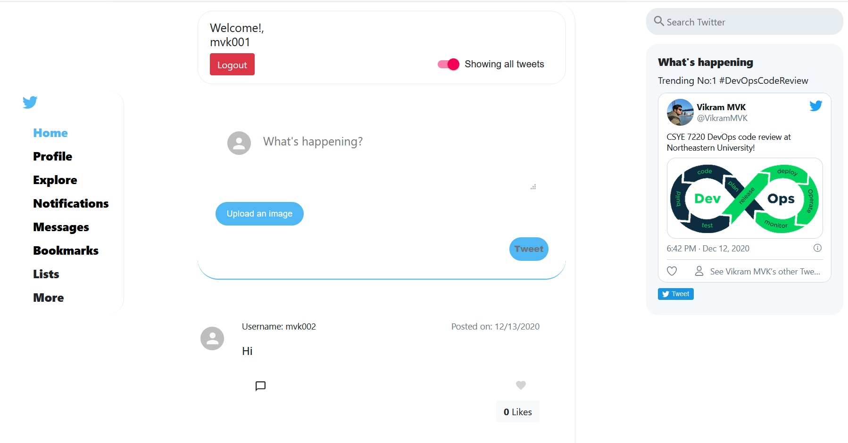
Screenshot - Homepage

Slide 12
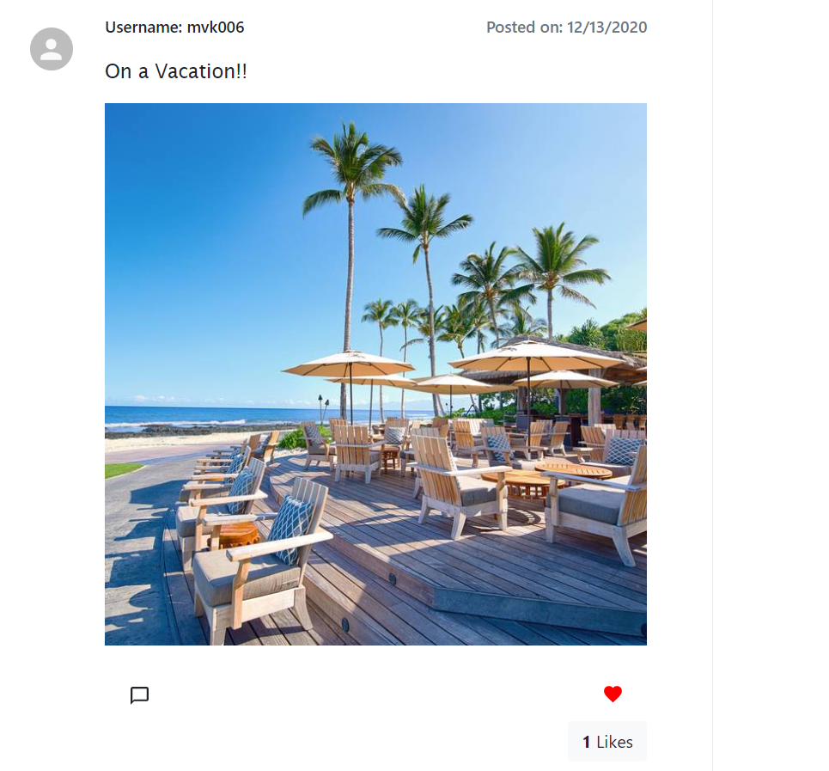
Image example

Slide 13
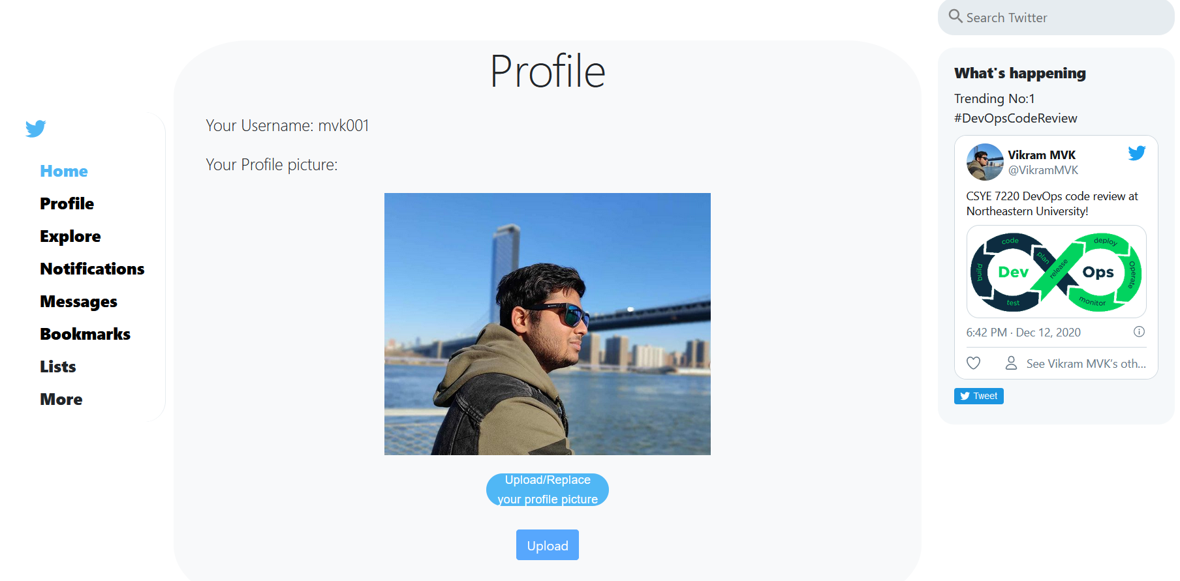
Profile page

Slide 14
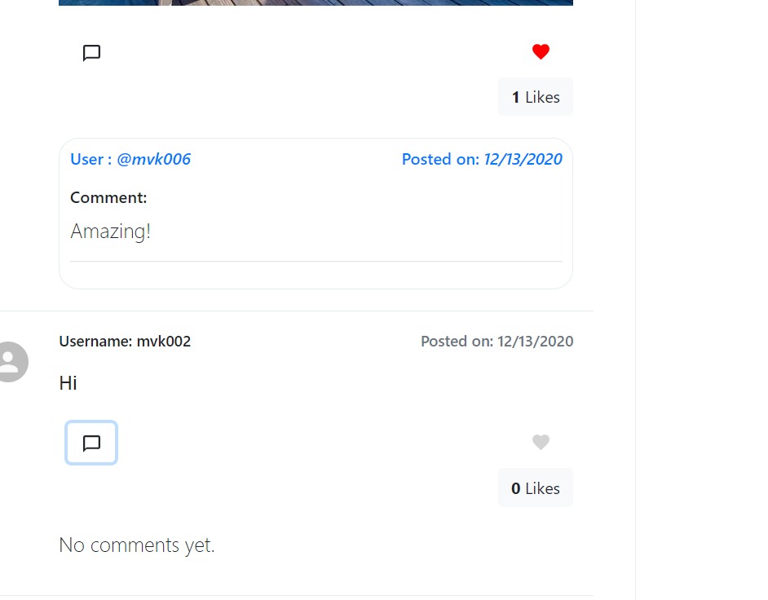
Comments

Slide 15
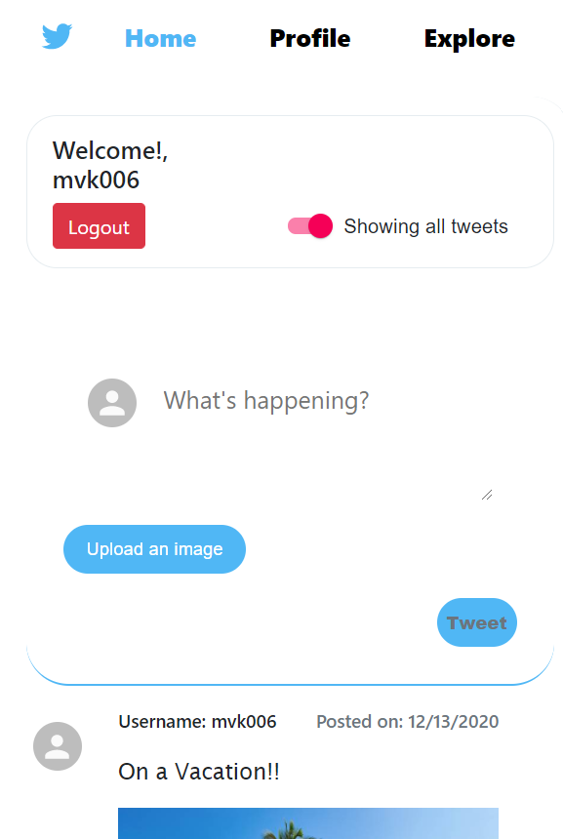
Mobile Mode

Slide 16
References:
Github: http://github.com/vikramzone
Docker hub: http://hub.docker.com/u/vikrammvk

